Slide 1






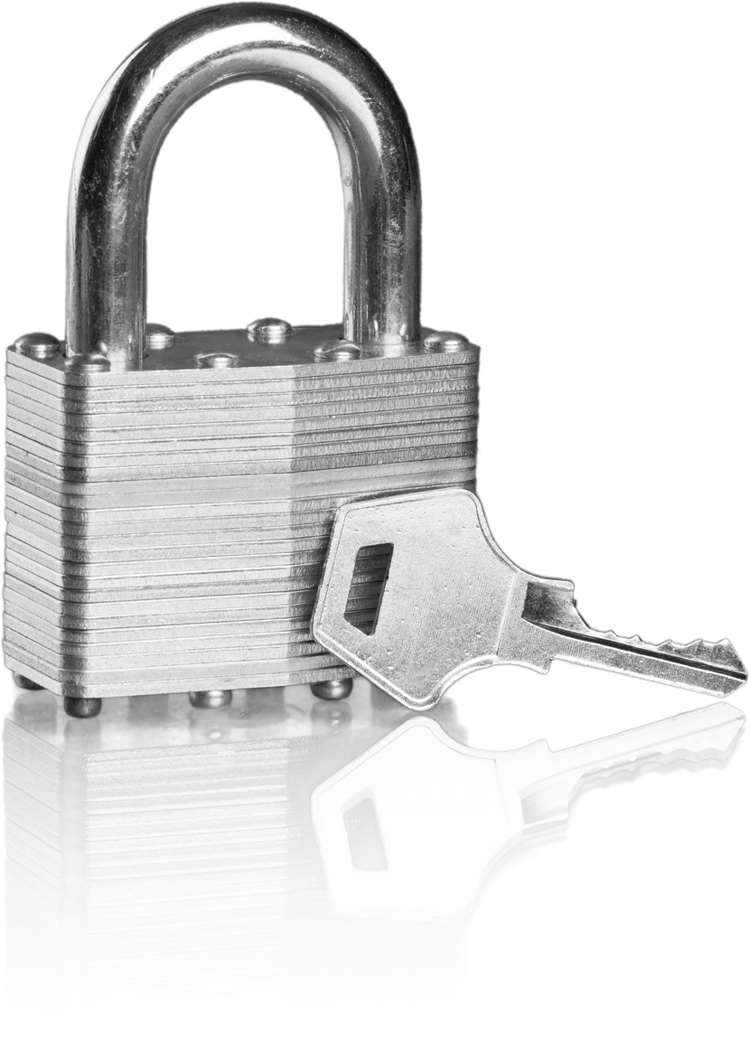



Thynk Unlimited
DATA INTEGRATION
SERVICES
Simplify your data integration for faster, more intelligent business decisions. Save 15% on all packages!
OUR SERVICES:
REAL-TIME DATA INTEGRATION
CLOUD DATA INTEGRATION
More Information At
www.reallygreatsite.com

Slide 2


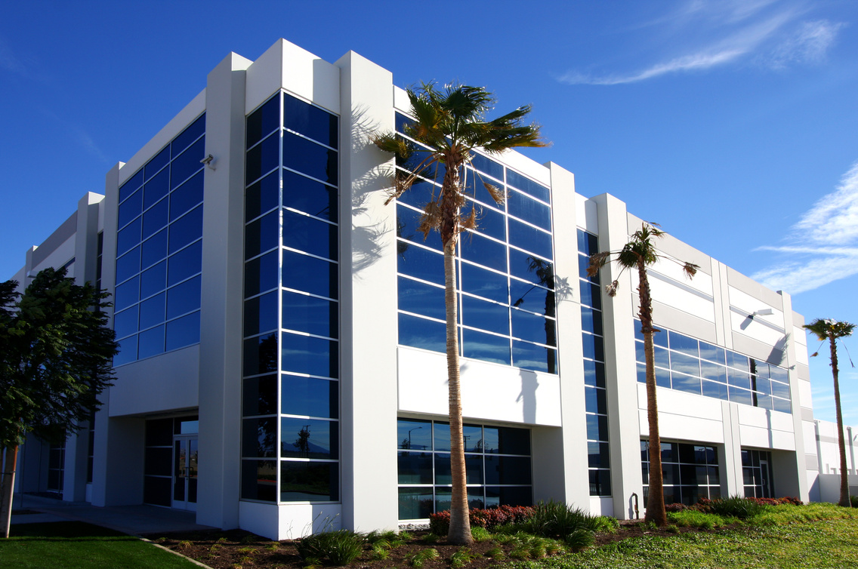






Warner & Spencer
DISCOVERY PHASE
Phase
Identify goals and gather essential project information.
01
PLANNING PHASE
Phase
Develop detailed strategies and define project milestones.
02
EXECUTION PHASE
Implement solutions and monitor progress effectively.
Project Timeline
Phase
03
REVIEW PHASE
Evaluate results and optimize for future success.
Phase
04
www.reallygreatsite.com

